Slide 1
Ⅰ-1-1-3 : CRITICAL PROCESS/PARAMETERS HAS BEEN IDENTIFIED & CROSS-VERIFICATION TO BE DONE DAILY BY PATROLLING & PROCESS AUDIT IN ALL SHIFTS TO REJECTION REDUCTION.
2022-2023 |  |  |  |  |  |  | IN-HOUSE REJECTION % RESULTS MONITORING
 | Index | Dept. | Unit | 1st half | 2nd half |  | Apr-22 | May-22 | Jun-22 | Jul-22 | Aug-22 | Sep-22 | Oct-22 | Nov-22 | Dec-22 | Jan-23 | Feb-23 | Mar-23
 |  |  |  | PLAN | PLAN
I-1 | Rejection Ratio | QA | REJ % | 0.20 | 0.14 | P | 0.24 | 0.24 | 0.24 | 0.21 | 0.21 | 0.21 | 0.18 | 0.18 | 0.18 | 0.16 | 0.16 | 0.16
 |  |  |  |  |  | A | 1.28 | 1.50 | 1.91
 |  |  |  |  |  | RESULT | Ï | Ï | Ï
IN JUNE-22 MONTH REJECTION TARGET NOT ACHIVED ,DUE TO GPDN KONA TCE MORE ISSUE AND CAM K0NA ,KOPA DECOMP HEIGHT NG, . MAJOR REJECTION CONTRIBUTING SECTION IN OVERALL REJECTION IS ,CAM SHAFT LINE ,GEAR-A & GEAR B LINE.

Slide 2
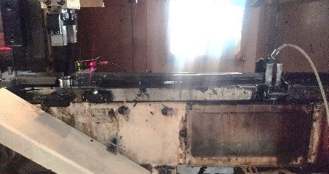
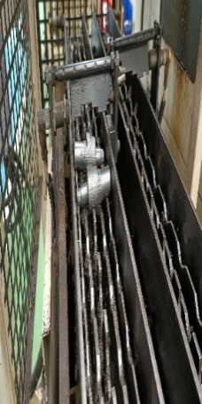
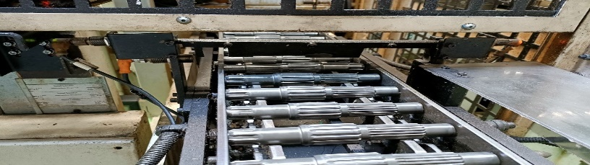
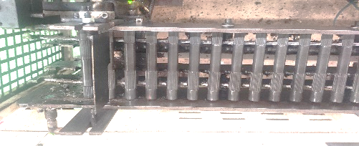
1.MONTHLY BASIS ALL LINE POKA-YOKE VERIFICATION DONE AS PER POKA-YOKE MONTHLY PLAN.
NG POKA-YOKE DETAILS
SECTION | PART NAME | MODEL | NG DETAILS | DEFECT PIC | RESP | TARGET DATE | STATUS
GEAR-B | GPD | K1CA | IF WRONG MODEL PART LOADED IN BROACHING INPUT CONVEYOR, IT WILL BE STOPPED BY SENSOR. From-25-04-22 |  | VIJAY | 10.05.22 18.06.22 18.07.22 | ∆
CAMLINE | CAM SHAFT L-4 | KOPA | F & C INPUT WRONG LOADING PART HAVE TO STOP BY STOPPER. From-05-04-22 |  | SANGAR | 11.05.22 17.06.22 26.06.22 | O
SHAFT-B | SHAFT COUNTER | KONA | GUN DRILLING INPUT WRONG LOADING PART HAVE TO STOP BY STOPPER. From-18-04-22 |  | PRABHBU | 05.05.22 17.06.22 20.07.22 | ∆
SHAFT-B | SKS | KONA | TURNING INPUT WRONG LOADING PART HAVE TO STOP BY STOPPER. From-12-04-22 |  | PRABHBU | 11.05.22 17.06.22 20.07.22 | ∆
WRONG MODEL PART NOT SENSED BY SENSOR
WRONG MODEL PART NOT SENSED BY SENSOR
SECTION WISE POKA-YOKE DETAILS
SECTION | TOTAL POKA-YOKE | OK | NG
GEAR-B | 43 | 42 | 1
HARD LINE | 30 | 30 | 0
GEAR-A | 21 | 21 | 0
CAM SHAFT | 14 | 13 | 1
ASSLY | 14 | 14 | 0
SHAFT-B | 7 | 5 | 2
SHAFT-A | 5 | 5 | 0
HT | 4 | 4 | 0
CON ROD | 3 | 3 | 0
TOTAL | 141 | 137 | 4
WRONG LOADING FLAPPER NOT WORKING
WRONG LOADING FLAPPER NOT WORKING
WRONG LOADING FLAPPER NOT WORKING
MODEL WISE SUMMARY OF POKA-YOKE-( POKAYOKE NG FOUND IN MAY-22 )

Slide 3
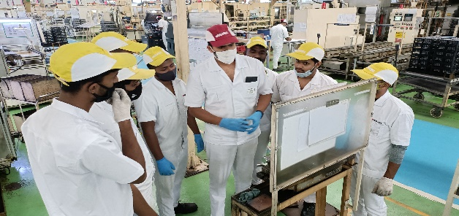
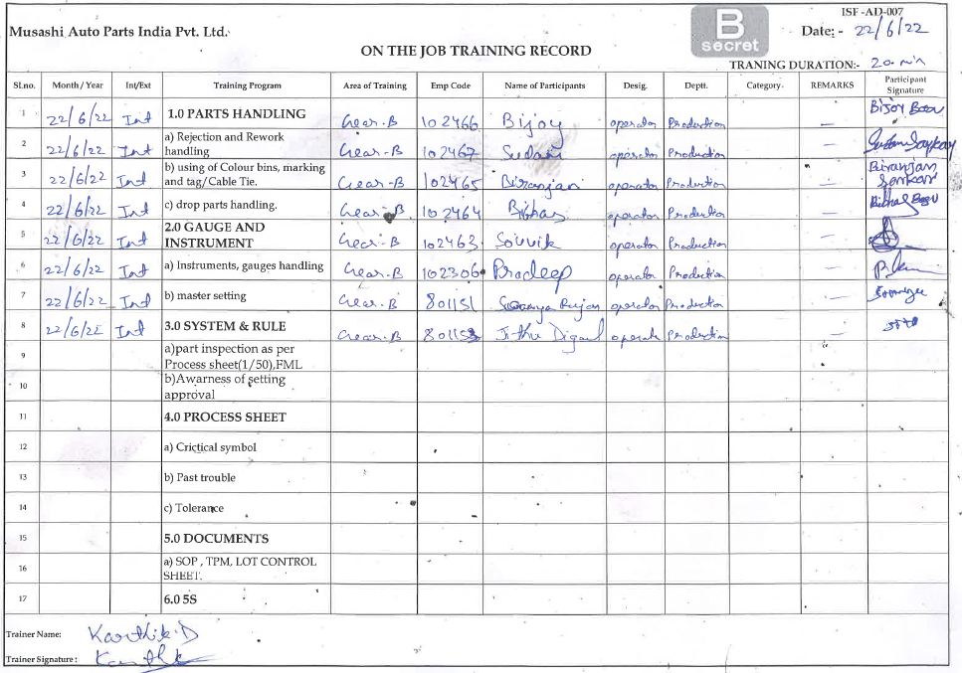
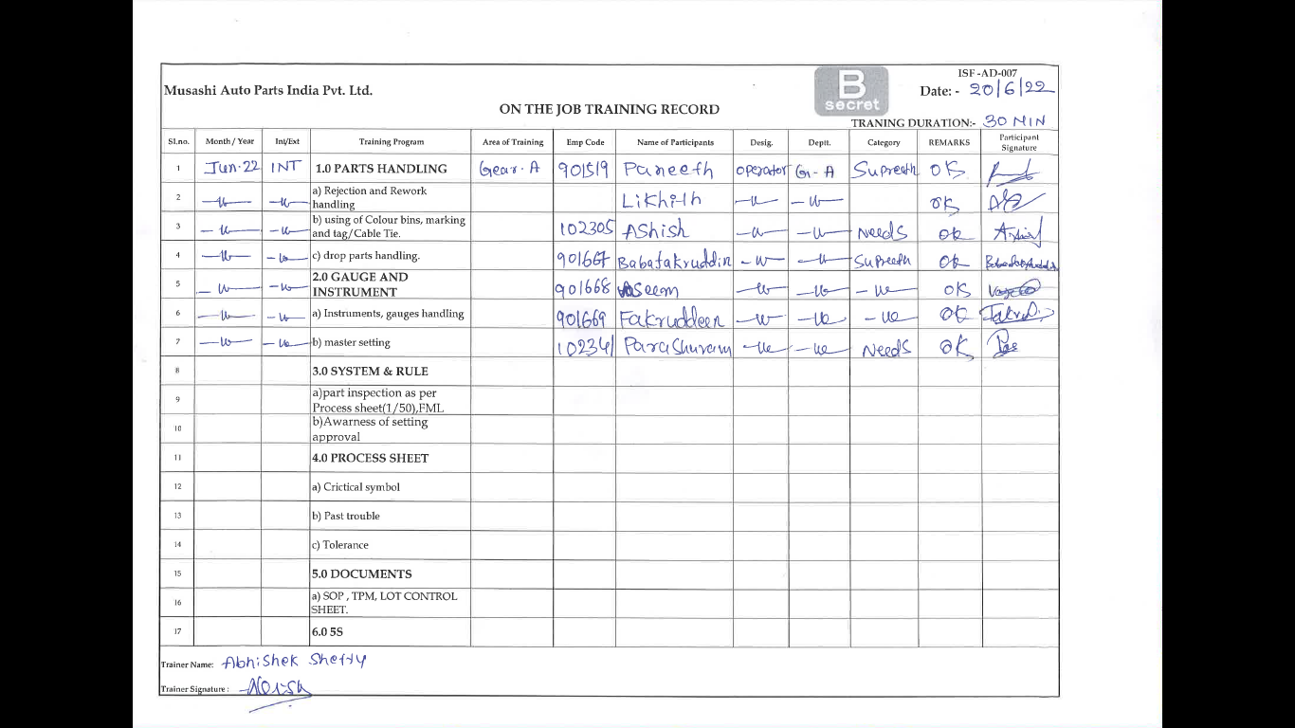
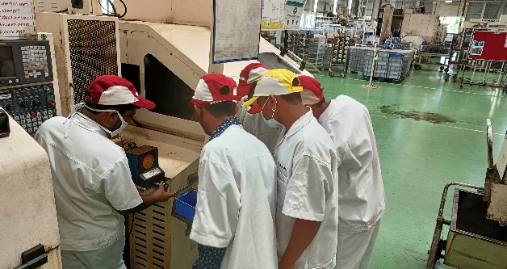
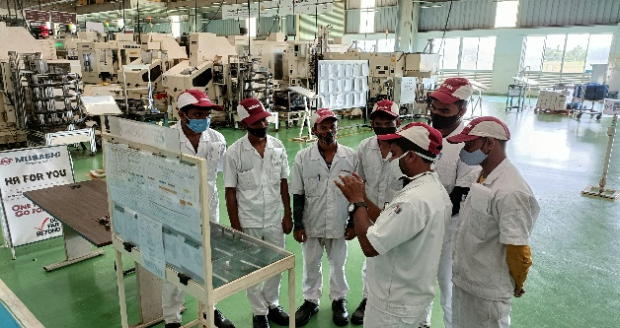
NEW JOINERS GEMBA OJT
Training Program\
1.0 PARTS HANDLING
a) Rejection and Rework handling
b) using of Colour bins, marking and tag/Cable Tie.
c) drop parts handling.
2.0 GAUGE AND INSTRUMENT
a) Instruments, gauges handling
b) master setting
3.0 SYSTEM & RULE
a)part inspection as per Process sheet(1/50),FML
b)Awarness of setting approval
4.0 PROCESS SHEET
a) Crictical symbol
b) Past trouble
c) Tolerance
5.0 DOCUMENTS
a) SOP , TPM, LOT CONTROL SHEET.
6.0 5S
OJT RECORD
GEMBA BASIC TRAINING IS DAILY GIVING BY INPROCESS QA TO NEW JOINERS FOR GROOMING.

